Slide 1

Transforming Chatbot Technology
Discover how specialized chatbots built with Transformer architecture are transforming knowledge acquisition in dedicated domains through the use of Topical Chat datasets.
By Liaqat Ali

Slide 2
The Power of Specialization
1
Personalize Experiences 🎯
2
Efficiency & Optimization 🚀
3
Enhanced User Experience ✨
Explore the benefits of tailoring chatbots to specific domains to improve user engagement and knowledge acquisition.
Learn how specialized chatbots can be optimized for specific tasks in a more efficient manner than a general conversational agent.
Discover how personalized chatbots lead to increased user satisfaction and can improve your brand reputation.

Slide 3
The Transformer Architecture
Self-Attention 🕵️‍♀️
Embedding & Encoding 🔨
Understand the foundation of the Transformer model, how it replaces RNNs, and how it utilizes multi-head self-attention for high-level semantic relationships.
Learn how input embeddings and encoding layers improve model performance by mapping contextual information to vector representations.
Decoding & Output 🤖
Fine-Tuning 🏋️‍♂️
Discover how the decoder component generates responses, uses a transformer language model, and outputs a probability distribution over the vocabulary.
Explore the importance of fine-tuning pre-trained models for chatbot usage and how the model adapts to specific domains.

Slide 4
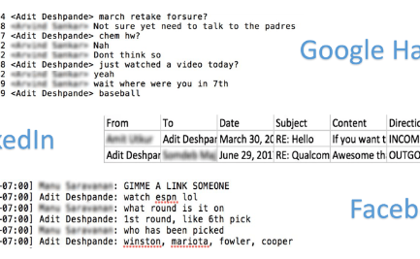


The Topical Chat Dataset
Specialized Domains
Data Cleaning
Model Training
Discover how data from dedicated domains is curated, preprocessed, and prepared for chatbot training.
Learn the importance of handling large datasets, techniques for cleaning, and techniques for text preprocessing.
Explore how the Transformer architecture is trained with topical datasets and what makes it different from other models.

Slide 5
The Evaluation Stage
Performance Metrics 🔍
Discover the various performance indicators used to measure chatbot performance and quality, including perplexity, F1 score, and BLEU.
1
2
3
Criteria for Success 🎯
Human Evaluation 🗣️
Understand how to define clear goals for chatbot usage and how to measure its success in achieving them.
Explore how human evaluators are used to assess the chatbot's performance in natural language understanding, voice, sentiment analysis, and more.

Slide 6
The Importance of Personalization
User Satisfaction 🙌
Brand Building 🏆
User Experience 🌟
Discover how personalized chatbots maximize user satisfaction by leveraging user data and feedback to continuously improve responses and experiences.
Explore how personalized chatbots enhance the brand image and reputation by providing tailored, authoritative responses within a specific domain.
Learn how personalization leads to improved user experience by providing relevant answers that allow users to achieve their objectives faster and more effectively.

Slide 7
Future Directions
Multi-Domain Chatbots 🌐
Automated Training 🤖
Voice Integration 🔊
Explore the integration of personalized chatbots with voice assistants and how it changes the way we interact with chatbots in a domain-specific context.
Explore the potential for chatbots to expand beyond their defined domain and provide a more natural user experience in handling cross-domain questions and tasks.
Discover how the chatbot's architecture can be improved through automatic training, as well as the impact of enhanced memory and multitasking capabilities.

